Slide 1


How to check videos and images?
This project has been funded with support from the European Commission. This communication reflects the views only of the author, and the Commission cannot be held responsible for any use whichmay be made of the information contained therein. Submission Number: 2019-1-DE02-KA204-006167.
This document by TEACH is licensed under CC BY-SA 4.0.
To view a copy of this license, visit
https://creativecommons.org/licenses/by-sa/4.0

Slide 2
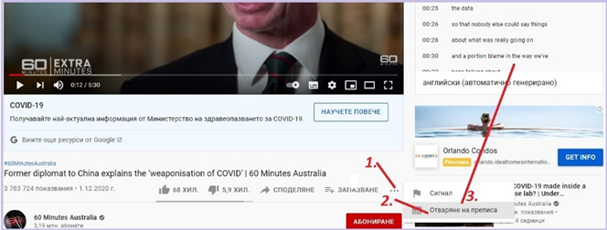
VIDEO
Open the video by following the link https://www.youtube.com/watch?v=CkCFDDCkG1k
Click on the three horizontal dots below it (1)
Оpen the transcript (2)
The transcript is open (3)

Slide 3
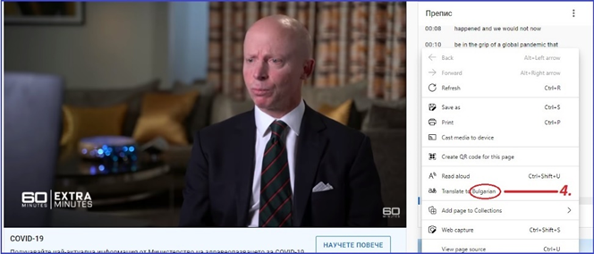
VIDEO
Right - click on the transcript and select the language (4)

Slide 4
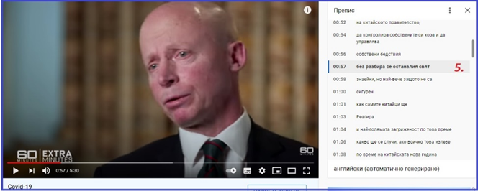
VIDEO
The transcript will be translated into your chosen language (5)

Slide 5
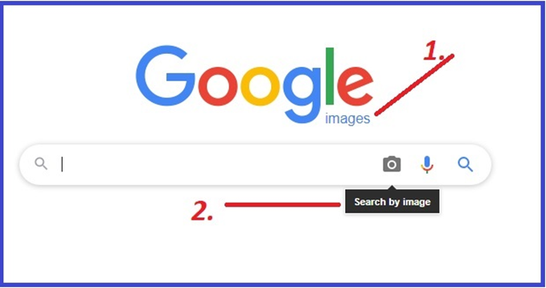
IMAGE
Open (1) https://www.google.com/imghp?hl=EN
Search by image (2)

Slide 6
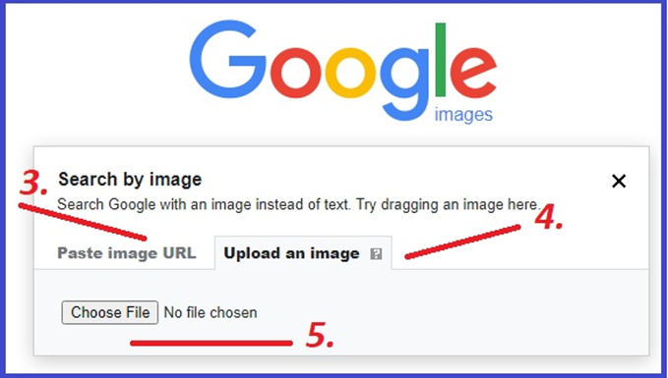
IMAGE
You can paste image URL (3) or upload an image (4) from your computer (5).

Slide 7
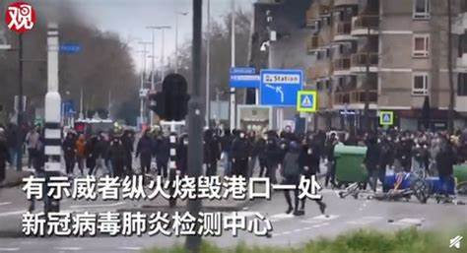
How we check the text on the photo?
Original Image

Slide 8
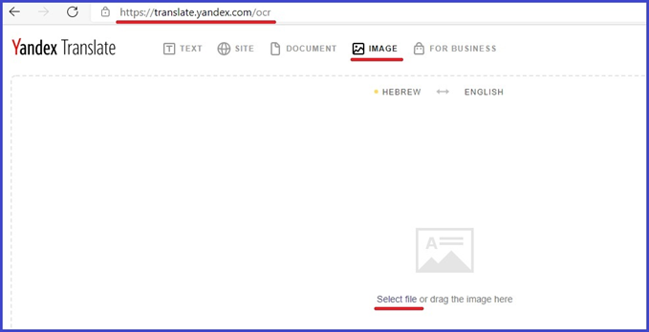
How we check the text on the photo?
Open the Image translator

Slide 9
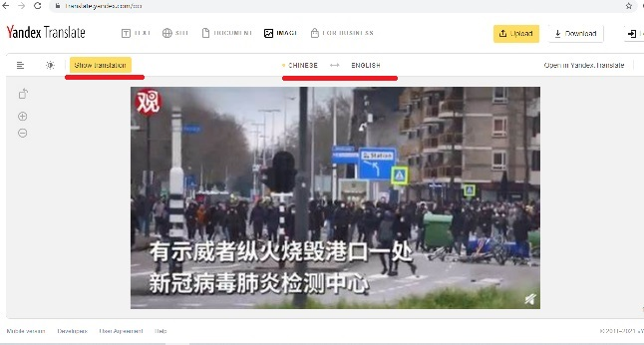
How we check the text on the photo?
Select an image from your computer

Slide 10
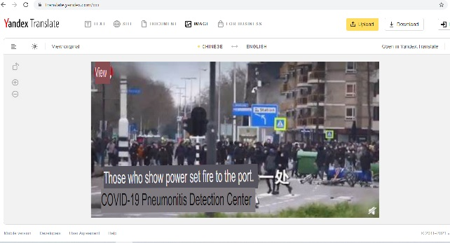
How we check the text on the photo?
Select a language and translate

Slide 11
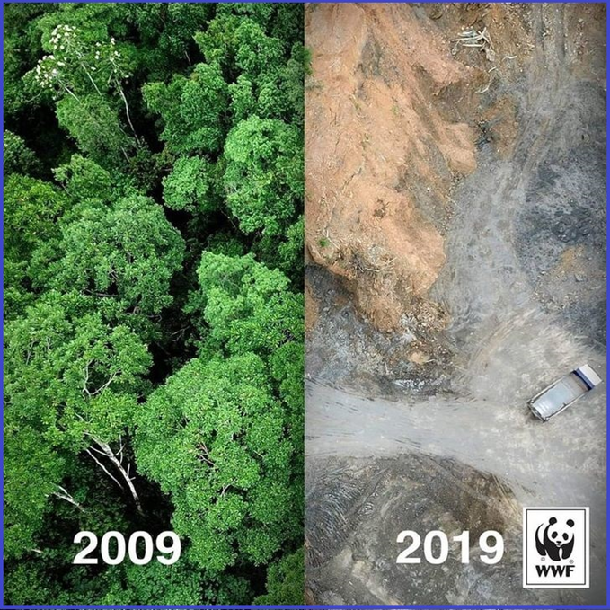
Individual work
Photo 1.

Slide 12
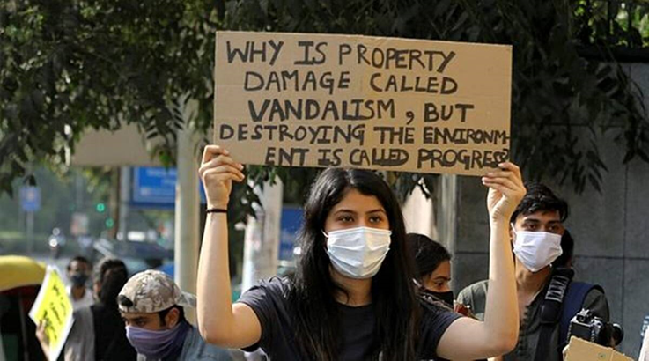
Individual work
Photo 2.

Slide 13


Thank you for your attention

